Slide 1





Smart Green House Monitoring And Control System
Guide : Prof. Ayubkhan Mulani Sir
Onkar Mahadev Chougale
Mangesh Ramesh Shinde
Sanket Dnyaneshwar Rajgude

Slide 2

CONTENTS :-
INTRODUCTION
BLOCK DIAGRAM
COMPONENT
SPECIFICATION OF COMPONENTS
FLOW-CHART
LITERETURE SURVEY
CIRCUIT DIAGRAM
HARDWARE IMPLEMENTATION
RESULT
ADVANTAGES
APPLICATION
FUTURE SCOPE
REFERENCES

Slide 3

INTRODUCTION :-
Greenhouse agriculture is a widely adopted practice for growing crops in controlled environments, particularly in regions with harsh weather conditions or limited land availability. However, maintaining optimal environmental conditions for plant growth in greenhouses can be challenging and often requires a significant amount of manual intervention. The use of technology such as Smart Greenhouse Monitoring and Control Systems can help automate and optimize the greenhouse environment, leading to improved crop yields and reduced labor costs. A Smart Greenhouse Monitoring and Control System typically consists of various sensors and control mechanisms that monitor and adjust environmental factors such as temperature, humidity, light intensity, and soil moisture. These systems use data analysis and decision-making algorithms to adjust environmental conditions in real-time, ensuring that the optimal conditions for plant growth are maintained. Additionally, many Smart Greenhouse Monitoring and Control Systems are web-based, allowing growers to remotely monitor and control the greenhouse environment from anywhere with an internet connection. In this study, we developed a Smart Greenhouse Monitoring and Control System using a Raspberry Pi 3, DHT11 sensor, soil moisture sensor, LDR sensor, fan, motor pump, LED light, and web-camera. The system continuously monitored and controlled the environmental conditions within the greenhouse, while also providing live feed of the greenhouse on a web page. We evaluated the performance of the system in a greenhouse setting and found that it effectively maintained the desired environmental conditions for plant growth. This paper presents the details of our Smart Greenhouse Monitoring and Control System, along with an evaluation of its performance and potential applications in greenhouse agriculture

Slide 4
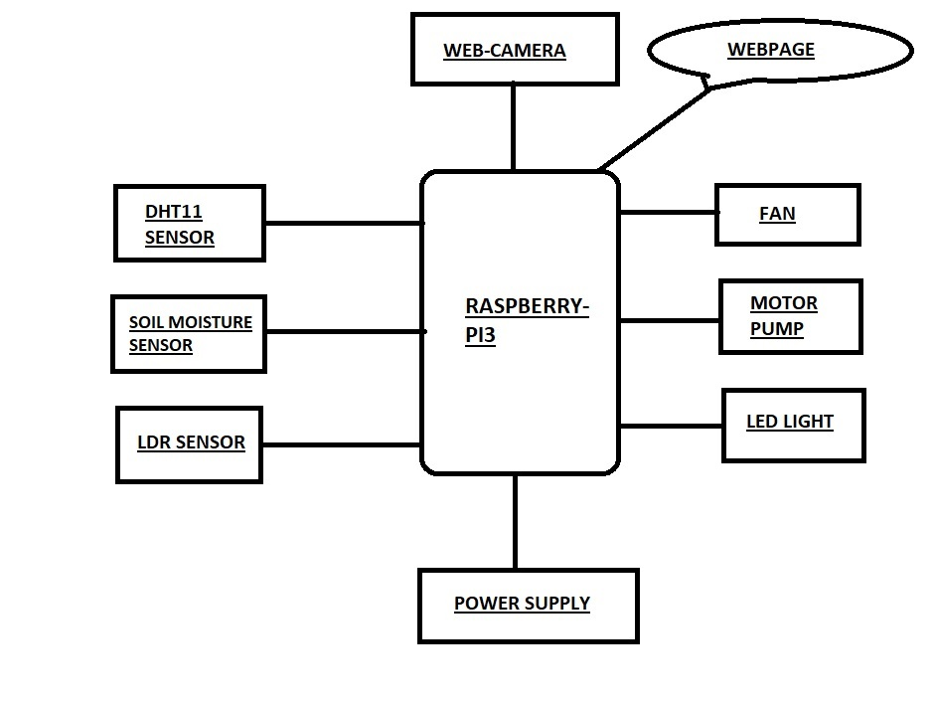
BLOCK DIAGRAM :-

Slide 5

COMPONENTS :-
Hardware Requirements :-
Raspberry Pi3
DHT11 Sensor
Soil Moisture Sensor
LDR Sensor
Exhaust Fan
Water Pump
LED Light
Web-Camera

Slide 6
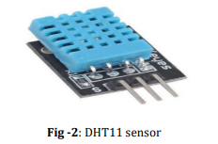
DHT11 SENSOR :-
DHT11 is small in size with operating voltage from 3 to 5 volts. The maximum current used while measuring is 2.5mA. DHT11 sensor has four pins- VCC, GND, Data Pin and a not connected pin. A pull-up resistor of 5k to 10k ohms is provided for communication between sensor and micro-controller.

Slide 7
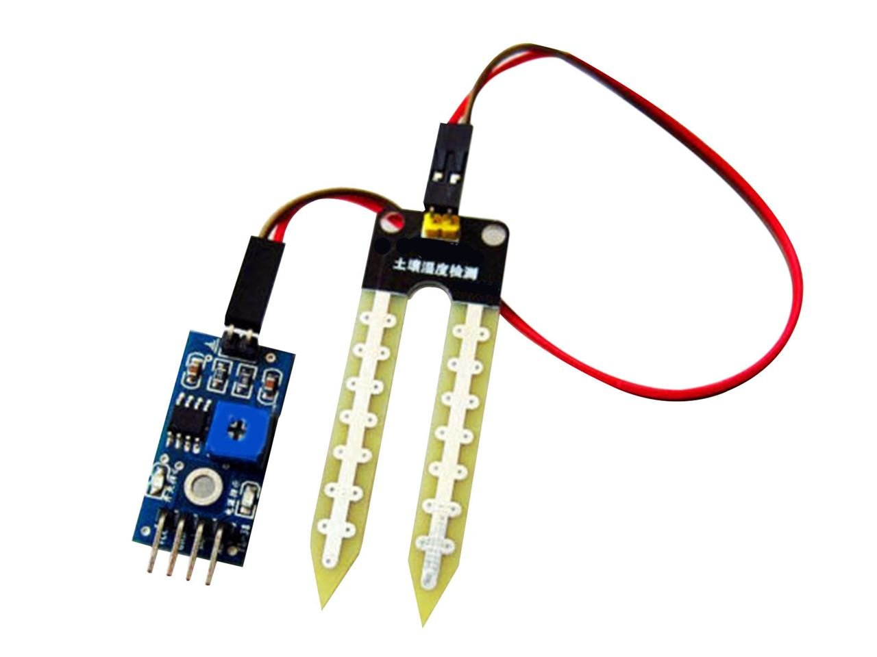
SOIL MOISTURE SENSOR :-
Soil moisture sensors measure or estimate the amount of water in the soil. These sensors can be stationary or portables such as handheld probes. Stationary sensors are placed at the predetermined locations and depths in the field, whereas portable soil moisture probes can measure soil moisture at several locations.

Slide 8
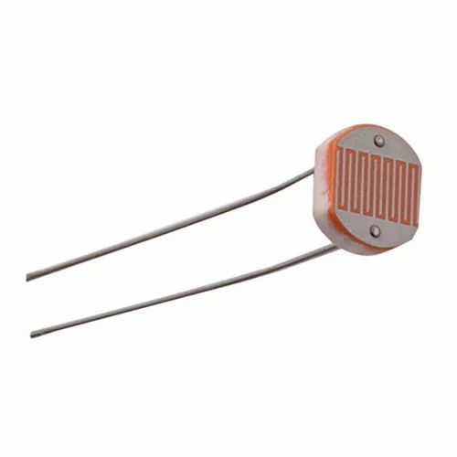
LDR SENSOR :-
LDRs are tiny light-sensing devices also known as photoresistors. An LDR is a resistor whose resistance changes as the amount of light falling on it changes. The resistance of the LDR decreases with an increase in light intensity. This property allows us to use them for making light sensing circuits.

Slide 9
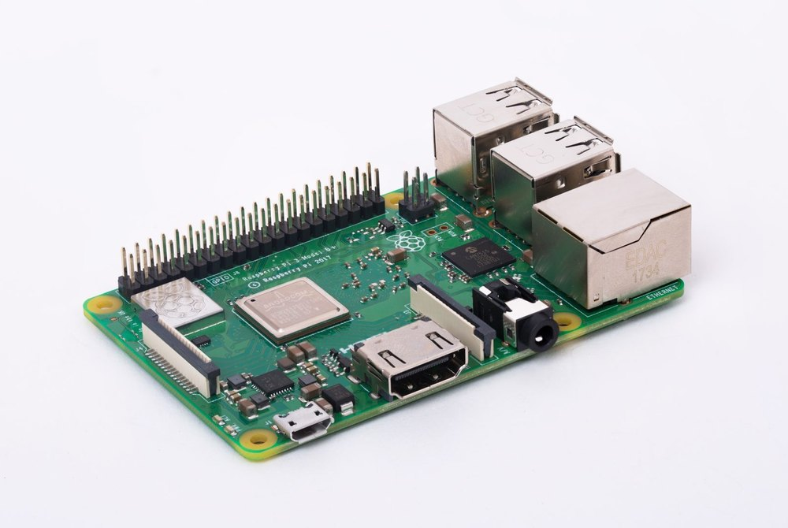
RASPBERRY PI3 :-
The Raspberry Pi 3 is equipped with a quad-core 64-bit Broadcom BCM2837 ARM Cortex-A53 SoC processor running at 1.2 GHz, making it about 50% more powerful than the Pi 2. Which means the new Raspberry Pi 3 can be used for office applications and web browsing.

Slide 10
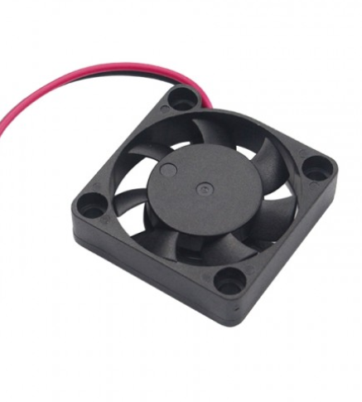
EXHAUST FAN:-
This is a miniature-size exhaust cooling fan. This fan is as small as your palm. Its working voltage is 5V DC. It can work with a simple 5V battery without any difficulty.

Slide 11
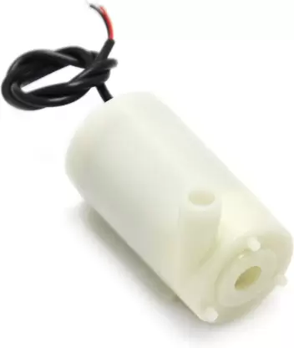
WATER PUMP :-
The water pump works using water suction method which drain the water through its inlet and released it through the outlet. You can use the water pump as exhaust system for your aqurium and controlled water flow fountain.

Slide 12
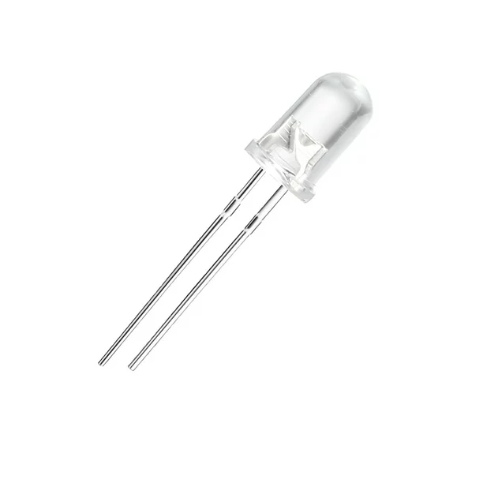
LED LIGHT :-
LED stands for light emitting diode. LED lighting products produce light up to 90% more efficiently than incandescent light bulbs. How do they work? An electrical current passes through a microchip, which illuminates the tiny light sources we call LEDs and the result is visible light.

Slide 13
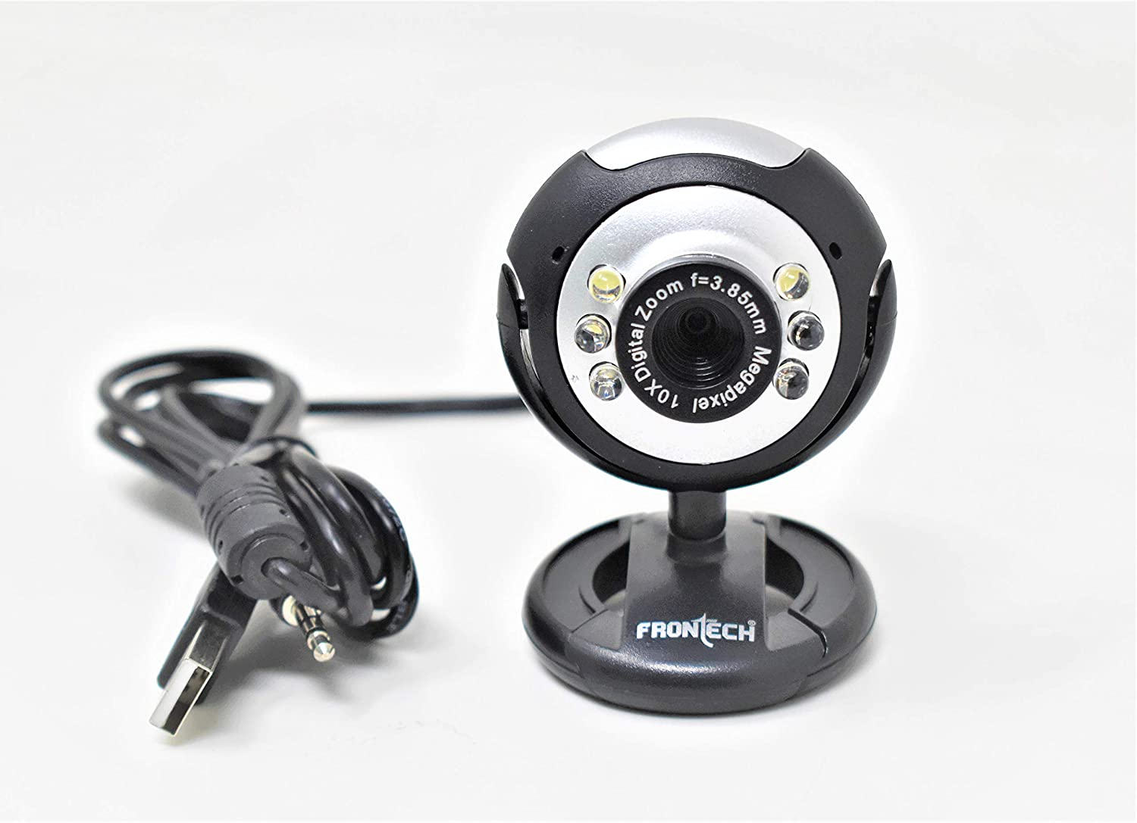
WEB-CAMERA :-
A webcam is a video camera which is designed to record or stream to a computer or computer network. They are primarily used in video telephony, live streaming and social media, and security.

Slide 14
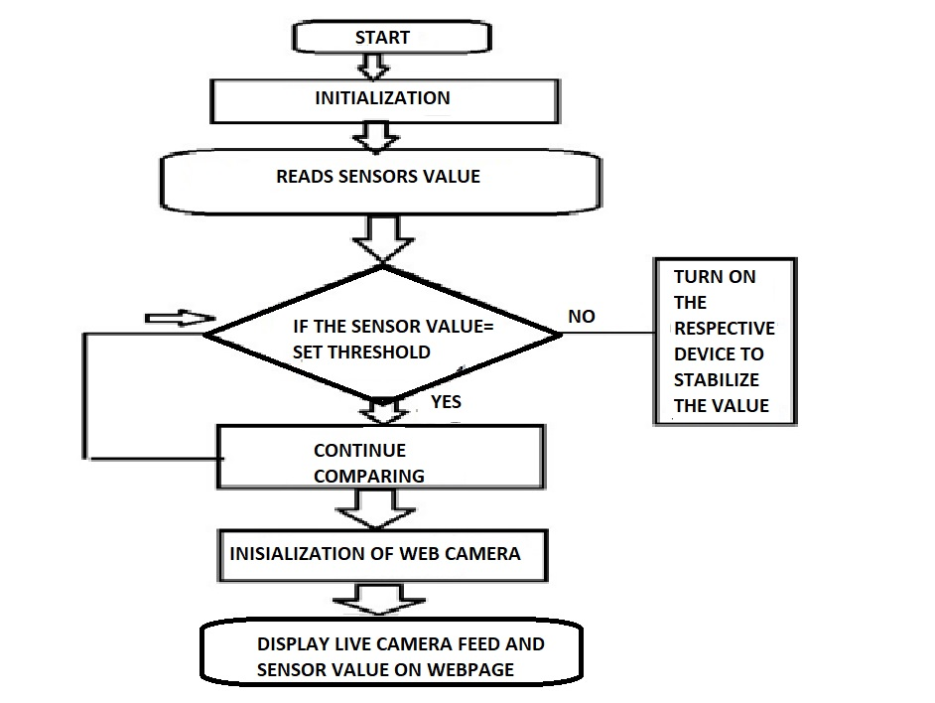
FLOWCHART :-
FLOW-CHART OF SMART GREEN HOUSE MONITORING AND CONTROL SYSTEM

Slide 15
LITERATURE SURVEY :-
SR.NO | Name | Author | Method | YEAR
1. | Design and Implementation of a Smart Greenhouse Monitoring and Control System. | Kim, Y. J., Park, J. H., Kim, J. H., & Lee, Y. I. | USING ARDUINO UNO | 2021
2. | An IoT-based Smart Greenhouse Monitoring System. | Khajoei, H., Sarvari, H., & Ghassemzadeh, H. | USING IOT TECHNOLOGY | 2019
3. | Smart greenhouse monitoring and control using Raspberry Pi and Arduino. | Rana, S., Bhattacharya, S., & Ghosh, A. | USING RASPBERRY PI AND ARDUINO | 2018
4. | IOT Based Greenhouse Monitoring System | Rupali Satpute , Hemant Gaikwad , Shoaib Khan , Aaditya Inamdar , Deep Dave | IOT BASED WIFI MODULE | 2018

Slide 16
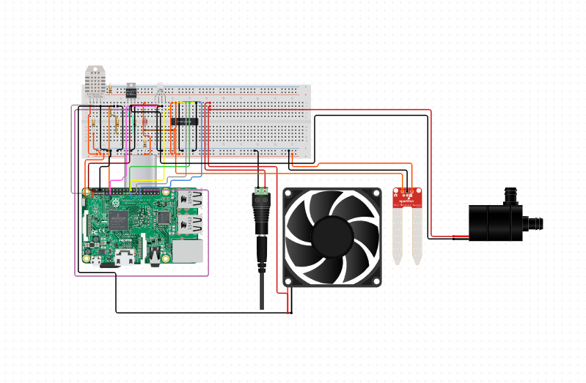
CIRCUIT DIAGRAM :-

Slide 17
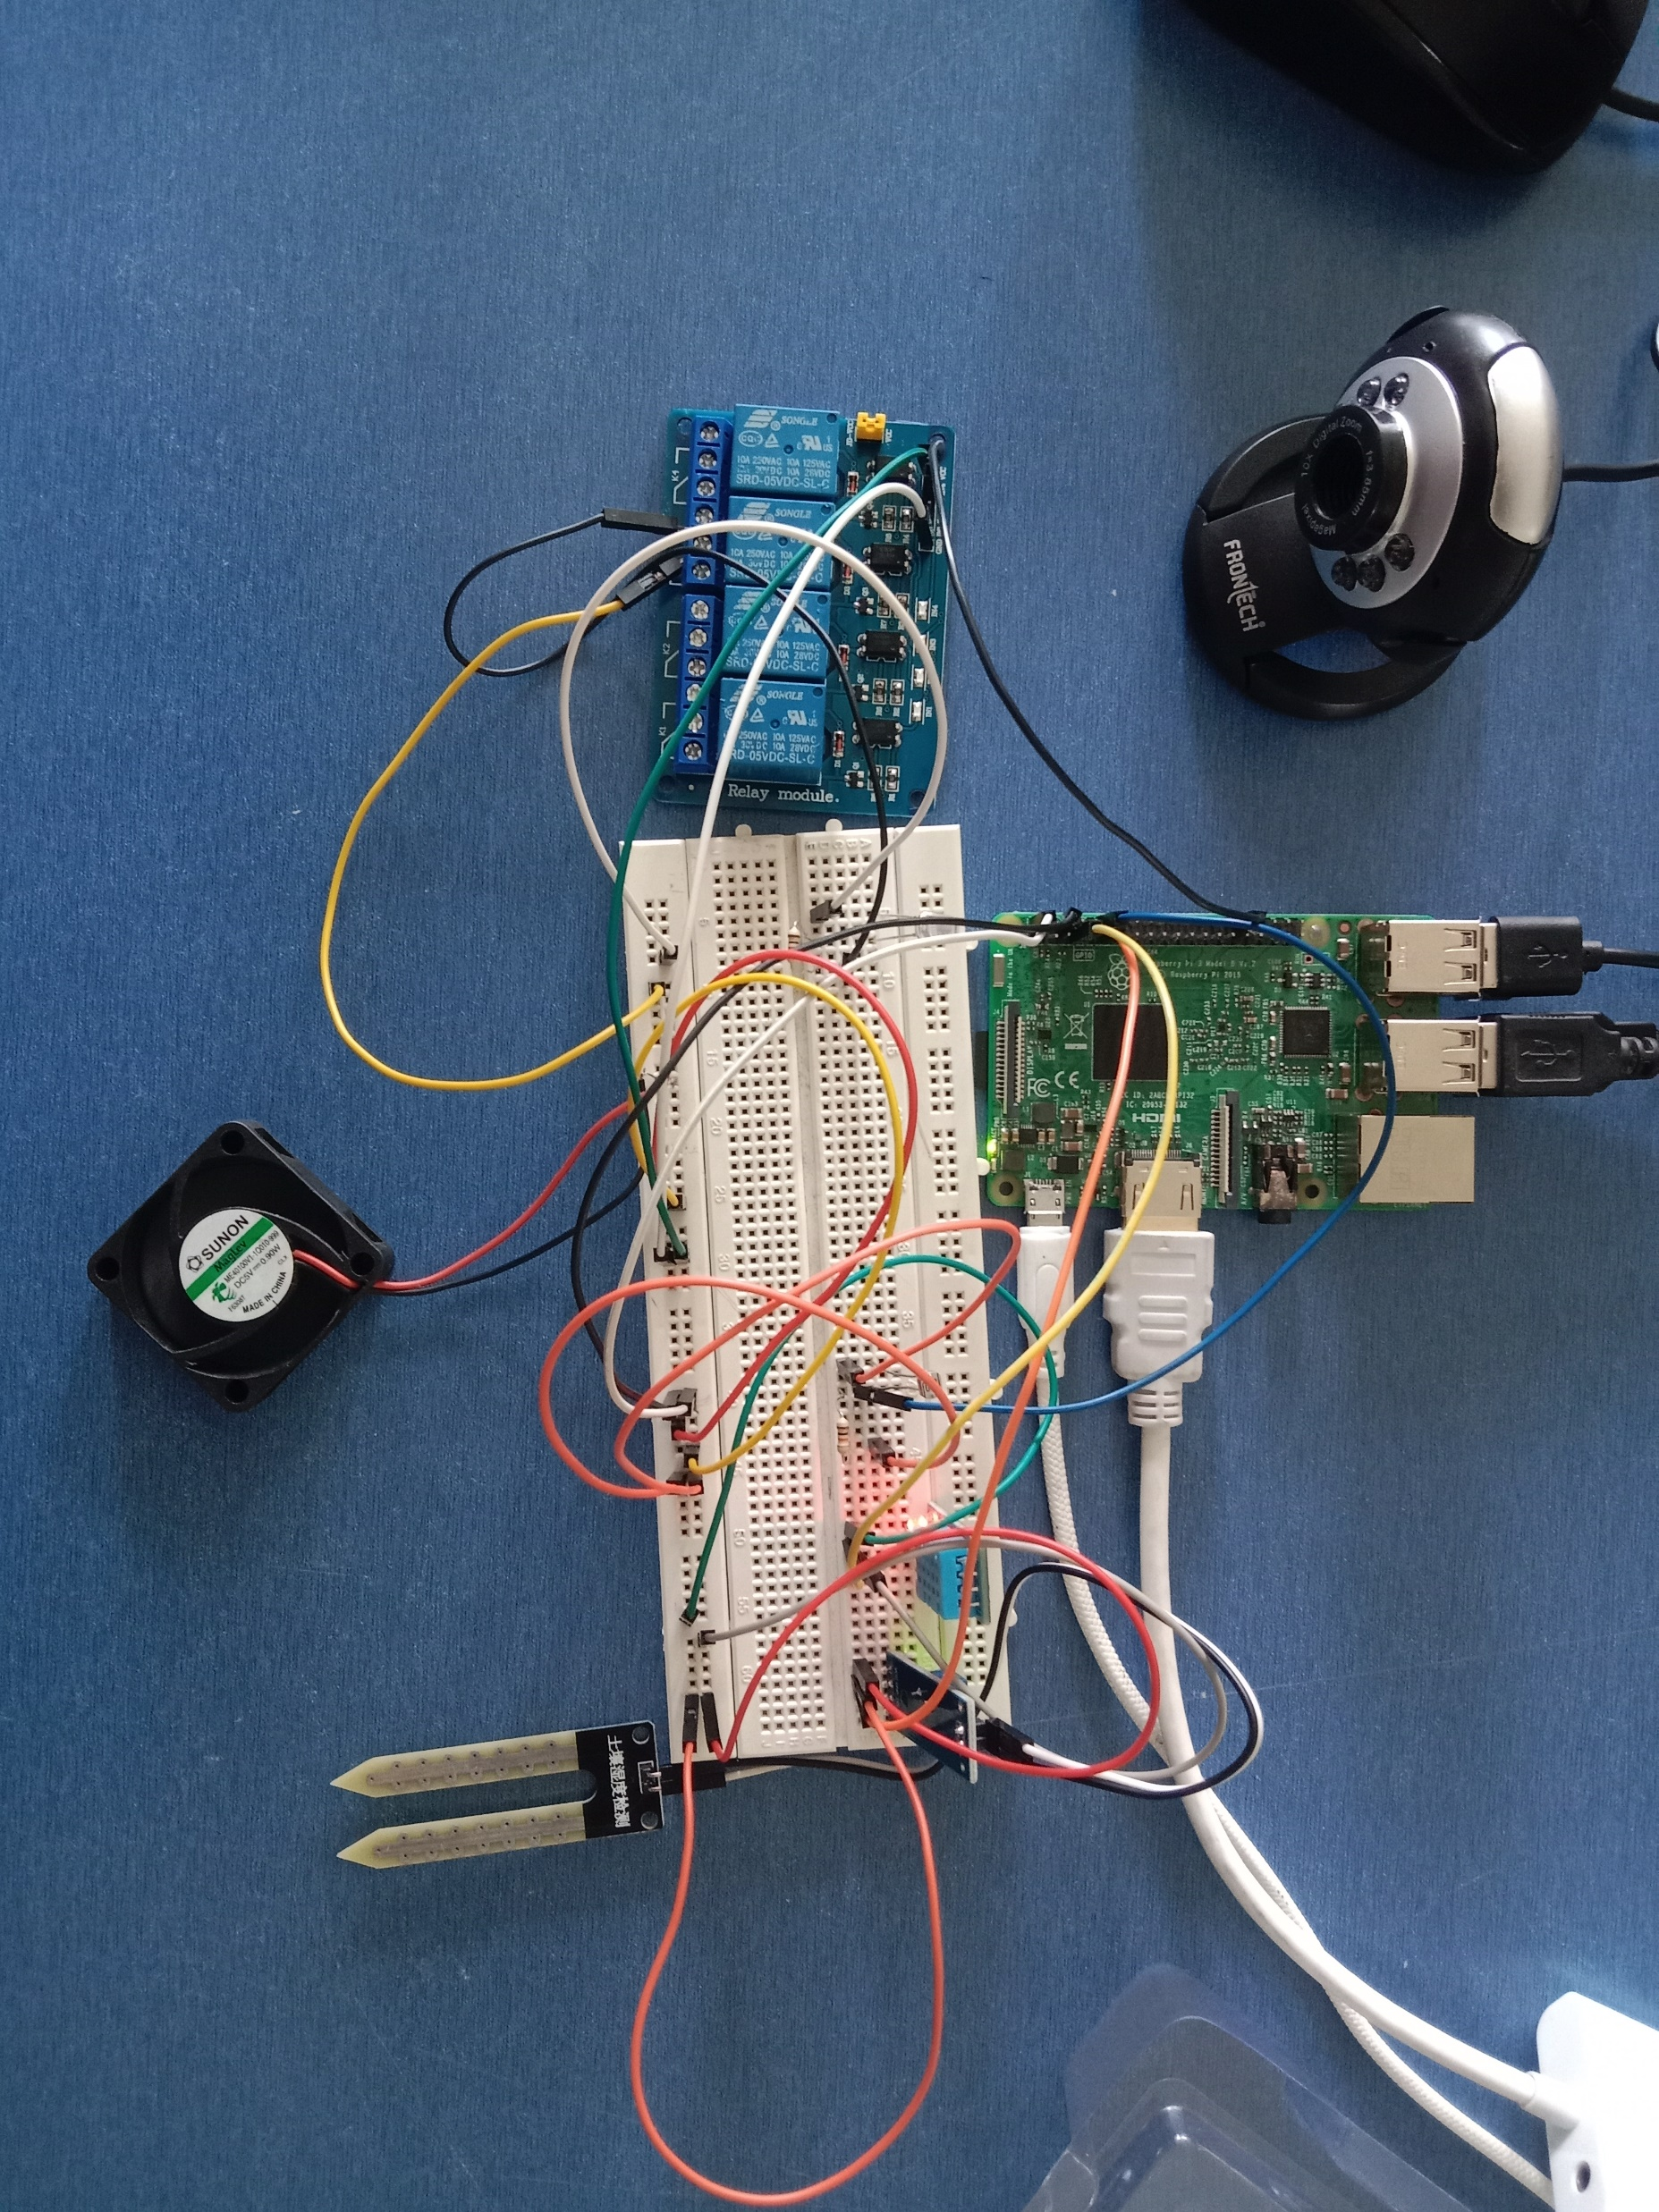
HARDWARE IMPLEMENTATION :-

Slide 18
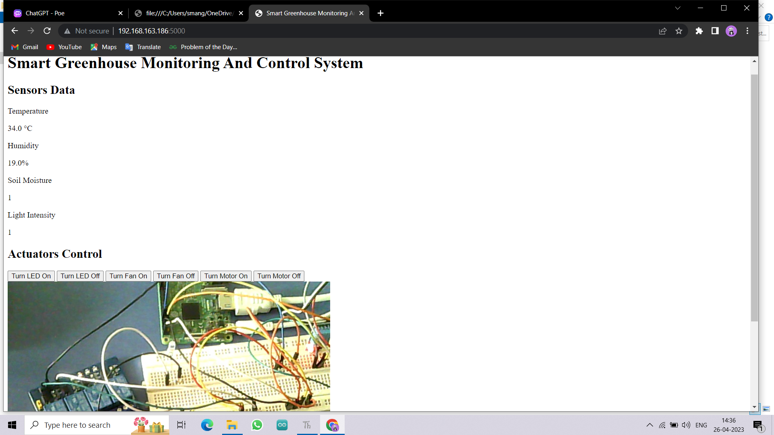
RESULT :-

Slide 19
APPLICATION :-
Rooftop greenhouse by any individual.
To protect the crop from high as well as low temperature and from rainfall.
To increase the yield of the crop for better crop management.
To grow crops in off-season and get the higher return.
To have the timely harvest and also improves the quality of the product.

Slide 20
ADVANTAGES :-
Produce insecticide free and pesticide free crops.
Create a climate for proper growth of plants.
This system can be installed by any individual in house.
It increases rate of growth of agricultural products.
Reduce the time and effort of farming.

Slide 21
FUTURE SCOPE :-
The login and password based (two factor authentication) scheme can be implemented
It is capable of providing uninterrupted mobile monitoring of the green house
We can predict the actual reactions to the ongoing changes in the greenhouse climate

Slide 22
REFERENCES :-
[1]. Khajoei, H., Sarvari, H., & Ghassemzadeh, H. (2019). An IoT-based Smart Greenhouse Monitoring System. In 2019 11th International Conference on Information Technology and Electrical Engineering (ICITEE) (pp. 192- 197). IEEE
[2].Kim, Y. J., Park, J. H., Kim, J. H., & Lee, Y. I. (2021). Design and Implementation of a Smart Greenhouse Monitoring and Control System. Journal of the Korean Society of Precision Engineering, 38(3), 249-257
[3]. Kummitha, R. K., Vutukuru, S. S., & Konatham, R. (2019). Smart Greenhouse Monitoring and Controlling Using IoT. In 2019 4th International Conference on Internet of Things: Smart Innovation and Usages (IoT-SIU) (pp. 1- 5). IEEE.
[4]. Li, X., & Han, S. (2019). Design and Implementation of Smart Greenhouse Monitoring and Control System Based on IoT Technology. In 2019 International Conference on Intelligent Manufacturing and Automation (ICIMA) (pp. 213-216). IEEE.
[5]. Nourian, M., Sepahi, A. A., & Javidi, M. (2017). Smart greenhouse monitoring and control system using Raspberry Pi and Arduino. International Journal of Engineering-Transactions C: Aspects, 30(2), 241-247.
[6]. Rana, S., Bhattacharya, S., & Ghosh, A. (2018). Smart greenhouse monitoring and control using Raspberry Pi and Arduino. In 2018 2nd International Conference on Inventive Systems and Control (ICISC) (pp. 422-426). IEEE
[7]. Sivaraman, A., Sridhar, V., & Karthikeyan, P. (2019). Smart Greenhouse Monitoring and Controlling System Based on IoT. In 2019 International Conference on Smart Electronics and Communication (ICOSEC) (pp. 89-94). IEEE

Slide 23
THANK YOU !!

